Slide 1
Capstone 3
By Trevor Johnson

Slide 2
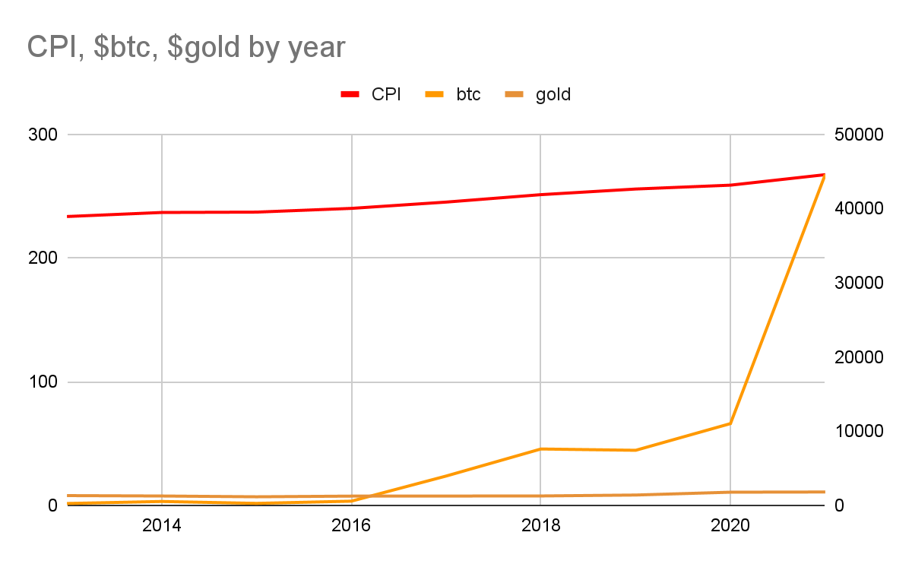
Introduction
Are the prices of gold and bitcoin correlated to the rate of inflation?
Confirm each commodities relevance as store of value

Slide 3
Data
Inflation Data: US CPI by Month from 1/1913-7/2021 from Kaggle
Yearmonth, CPI
Gold Price Data: Real time gold prices from 2012-2022 from Kaggle
Date, Close, Volume, Open, High, Low
Bitcoin Data: Price data for over 50 cryptocurrencies from 5/2013-10/2022 from Kaggle
Open, High, Low, Close, Volume, MarketCap, Coin, Date

Slide 4
Method
Created dataframes in Pandas for each dataset
Explored and removed unnecessary columns
Reformatted the date columns in order to match
Merged dataframes into a singular table
Used scatterplots to illustrate the relationship between CPI and Bitcoin and Gold prices
Used the Pearson correlation test to confirm correlations

Slide 5
Final Dataframe
Date | CPI | gold_open | gold_close | btc_open | btc_close
Ordinal | Continuous | Continuous | Continuous | Continuous | Continuous

Slide 6
Hypotheses
Hypothesis 1
Ho: There is no correlation between the price of Gold and the rate of inflation as measured by CPI
Ha: there is a correlation between the price of Gold and the rate of inflation as measured by CPI
Hypothesis 2
Ho: There is no correlation between the price of Bitcoin and the rate of inflation as measured by CPI
Ha: There is a correlation between the price of gold and the rate of inflation as measured by CPI

Slide 7
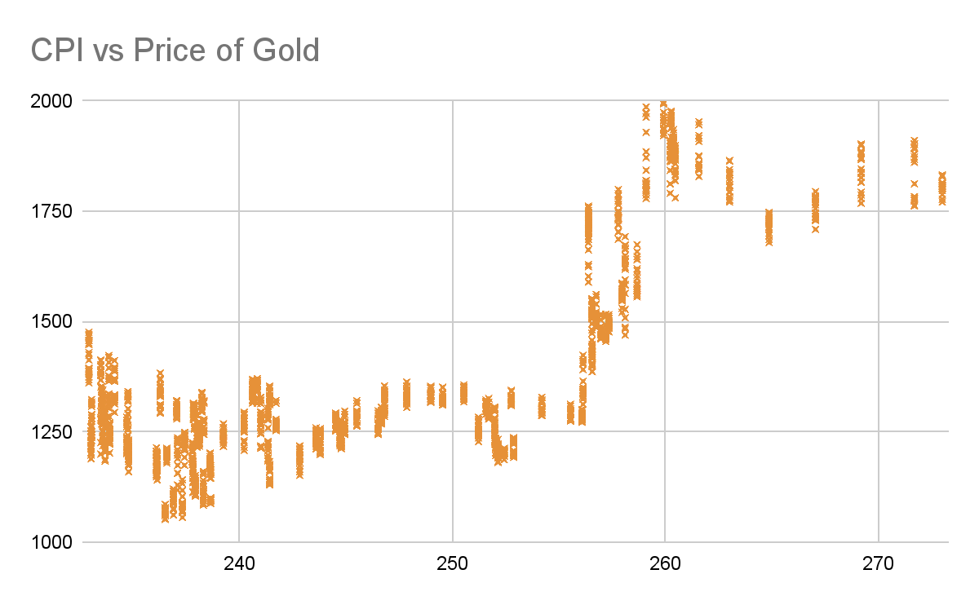
Pearsonr: CPI vs Gold
r=.76, p-value=0
Null rejected, there is a strong positive correlation between the rate of inflation and the price of Gold

Slide 8
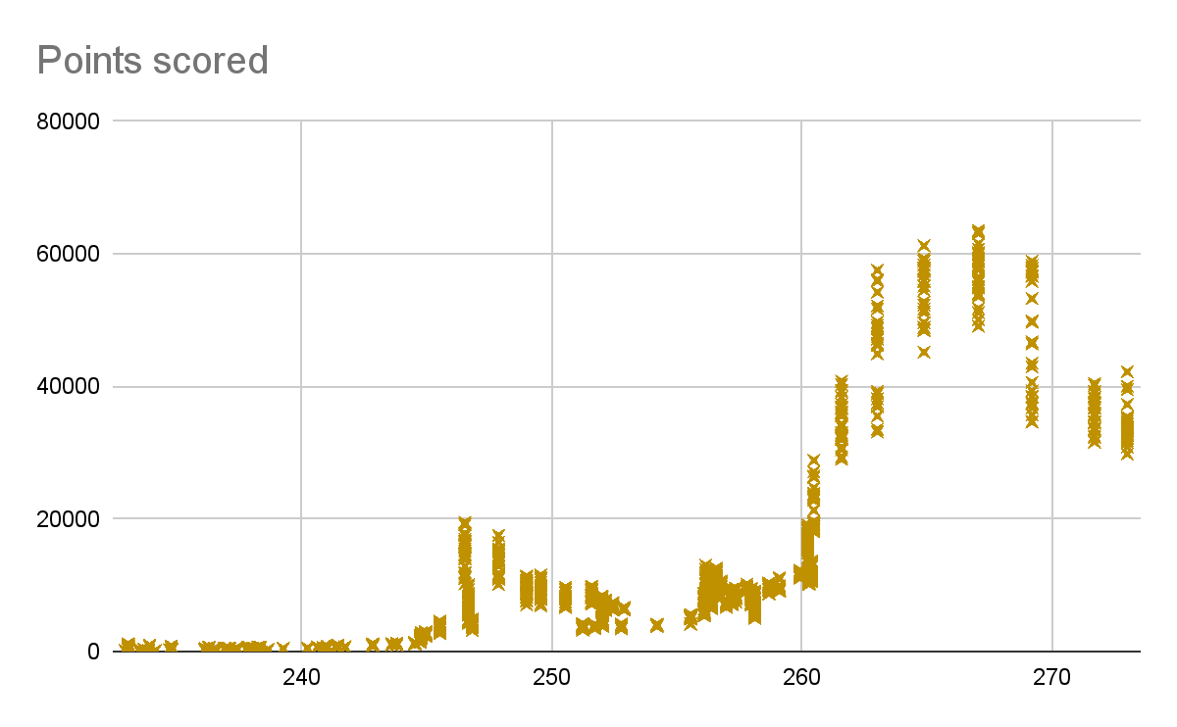
Pearsonr: CPI vs Bitcoin
r=.75, p-value=0
Null rejected, there is a strong positive correlation between the rate of inflation and the price of Bitcoin

Slide 9
Conclusion
There is a strong positive correlation between the Rate of Inflation as measured by CPI and the prices of Gold and Bitcoin

Slide 10
Next Steps
Obtain newer data
Has the CPI calculation changed?
Investigate price spikes when CPI reaches 260
Compare to other commodities

